Slide 1
Explanatory Data Analysis (EDA) on Unicorn Companies

Slide 2
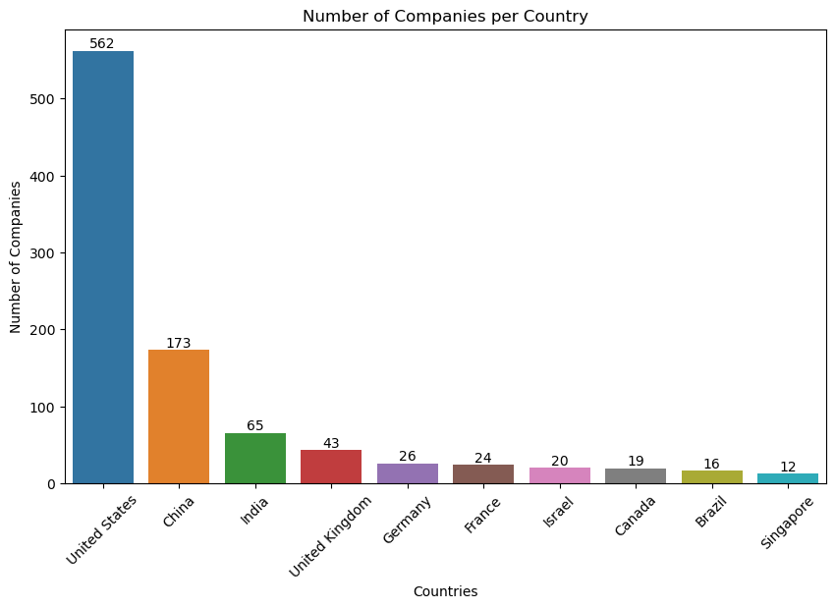
Countries that have the most unicorns United States has the highest number of Unicorn Companies totalling 562, followed by China with 173, India 65, the United Kingdom 43, and Germany 26.

Slide 3
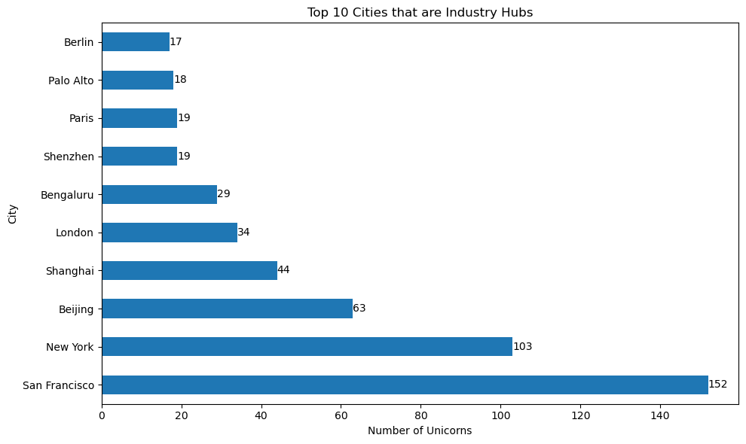
Top 10 cities that are industry hubs The city with the highest number of unicorn companies is San Francisco indicating its significance as an industry hub.

Slide 4
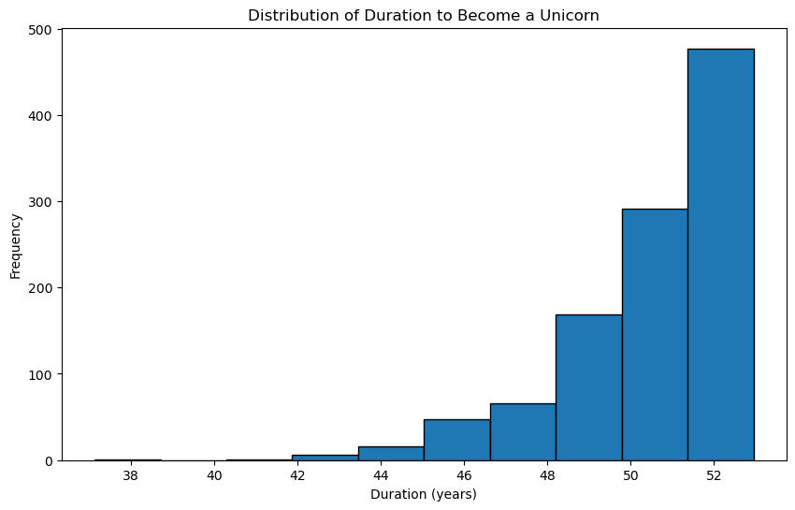
The distribution of duration to become a Unicorn Company On average, it takes approximately 50 years for a company to become a unicorn. The histogram reveals that the majority of companies take around 5-10 years to become unicorn companies. .

Slide 5
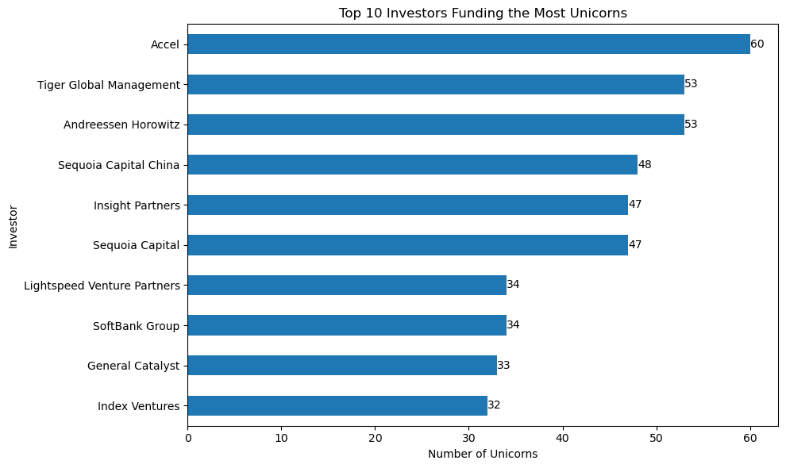
Investors that have funded the most unicorns. The top 10 investors that have funded the most unicorns include accel, tiger global management, andreessen horowitz and so on indicating their significant involvement in funding successful unicorn companies.

Slide 6
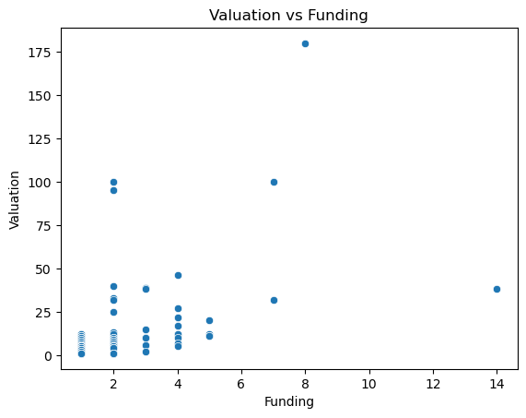
Relationship between funding and valuation for unicorn companies. The data shows that there is a positive relationship between funding and valuation for unicorn companies.

Slide 7
Data driven recommendations to help Unicorn Companies in creating good business models and making decisions
Look at the numbers to see which companies are worth a lot of money and getting a lot of funding. These companies are probably doing really well and have a good plan for making money.
Find out which types of businesses are growing quickly and have a lot of people interested in them. These are the businesses that are doing new and exciting things and have a lot of customers.
See who is in charge of the companies and how experienced they are in running successful businesses. It's important to have leaders who know what they're doing and have done well before.
Don't just invest in companies from one place. Spread the investments around different countries and regions. This way, if something goes wrong in one place, there are other places where the business can still do well.

